Slide 1

Making Apps More Human
AN INTRO TO MICROSOFT’S COGNITIVE SERVICES
Matthew Soucoup
PRINCIPAL
@codemillmatt codemilltech.com
Headshot optional

Slide 2


Slide 3

Unfamiliar places…

Slide 4
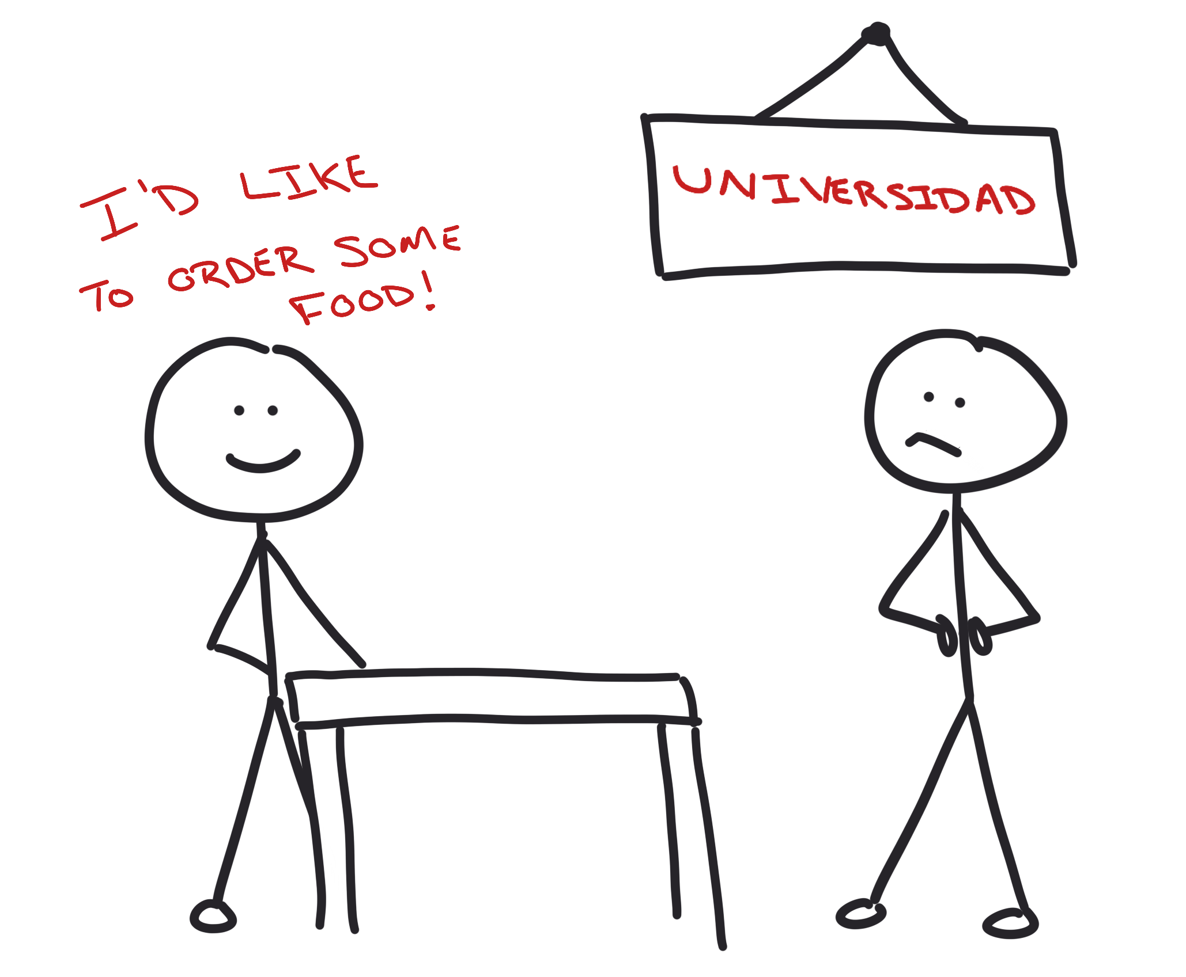
Strange signs…

Slide 5
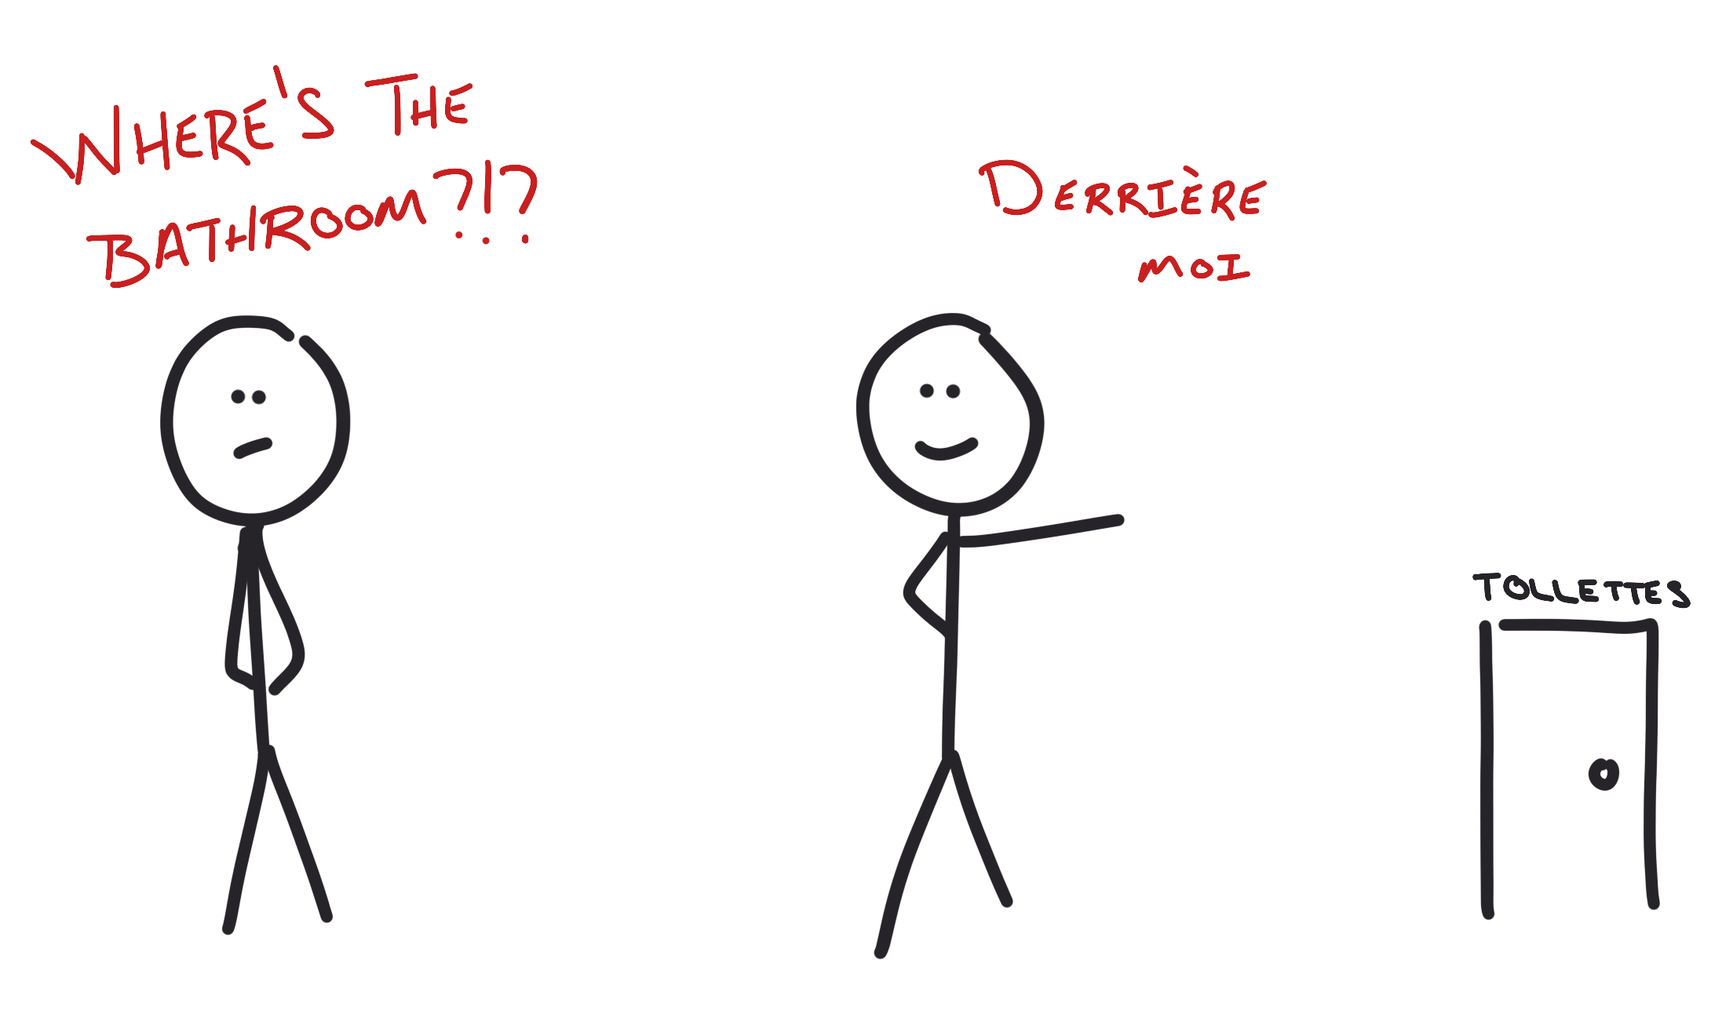
Different languages…

Slide 6

An app … that can be human?

Slide 7

Microsoft Cognitive Services

Slide 8
Cognitive Services - REST APIs
Vision
Speech
Language
Knowledge
Search

Slide 9







Vision
Content Moderator
Emotion
Video Indexer
Video API
Computer Vision
Face API
Custom Vision Service
Notes:
Computer vision
Content moderator
Video API
Video Indexer
Face API
Emotion API
Custom Vision Service

Slide 10




Speech
Bing Speech API
Custom Speech Service
Speaker Recognition
Translator API
Notes:
Translator
Bing
Recognition
Custom service

Slide 11






Language
Language Understanding
Web Language Model
Translator API
Text Analytics API
Bing Spell Check
Linguistics Analysis
Notes:
LUIS
Spell check
Language model
Text analytics
Translator
Lingustics analysis

Slide 12






Knowledge
QnA
Explorations
Recommendations API
Academic Knowledge API
Entity Linking
Custom Decision
Notes:
Recommendations
Explorations
Entity Linking
Academic
QnA
Custom decision

Slide 13







Search
Bing News API
Entity
Search API
Bing Autosuggest API
Video API
Custom Search API
Image API
Notes:
Autosuggest
News
Web
Entity
Image
Video
Custom

Slide 14

The Vacation…

Slide 15
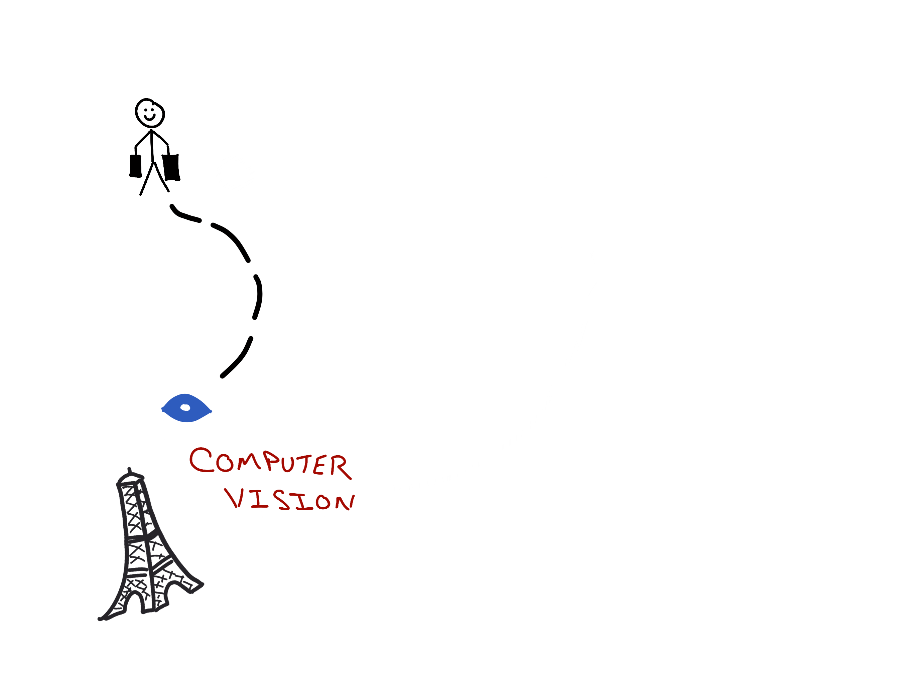
The Vacation…

Slide 16
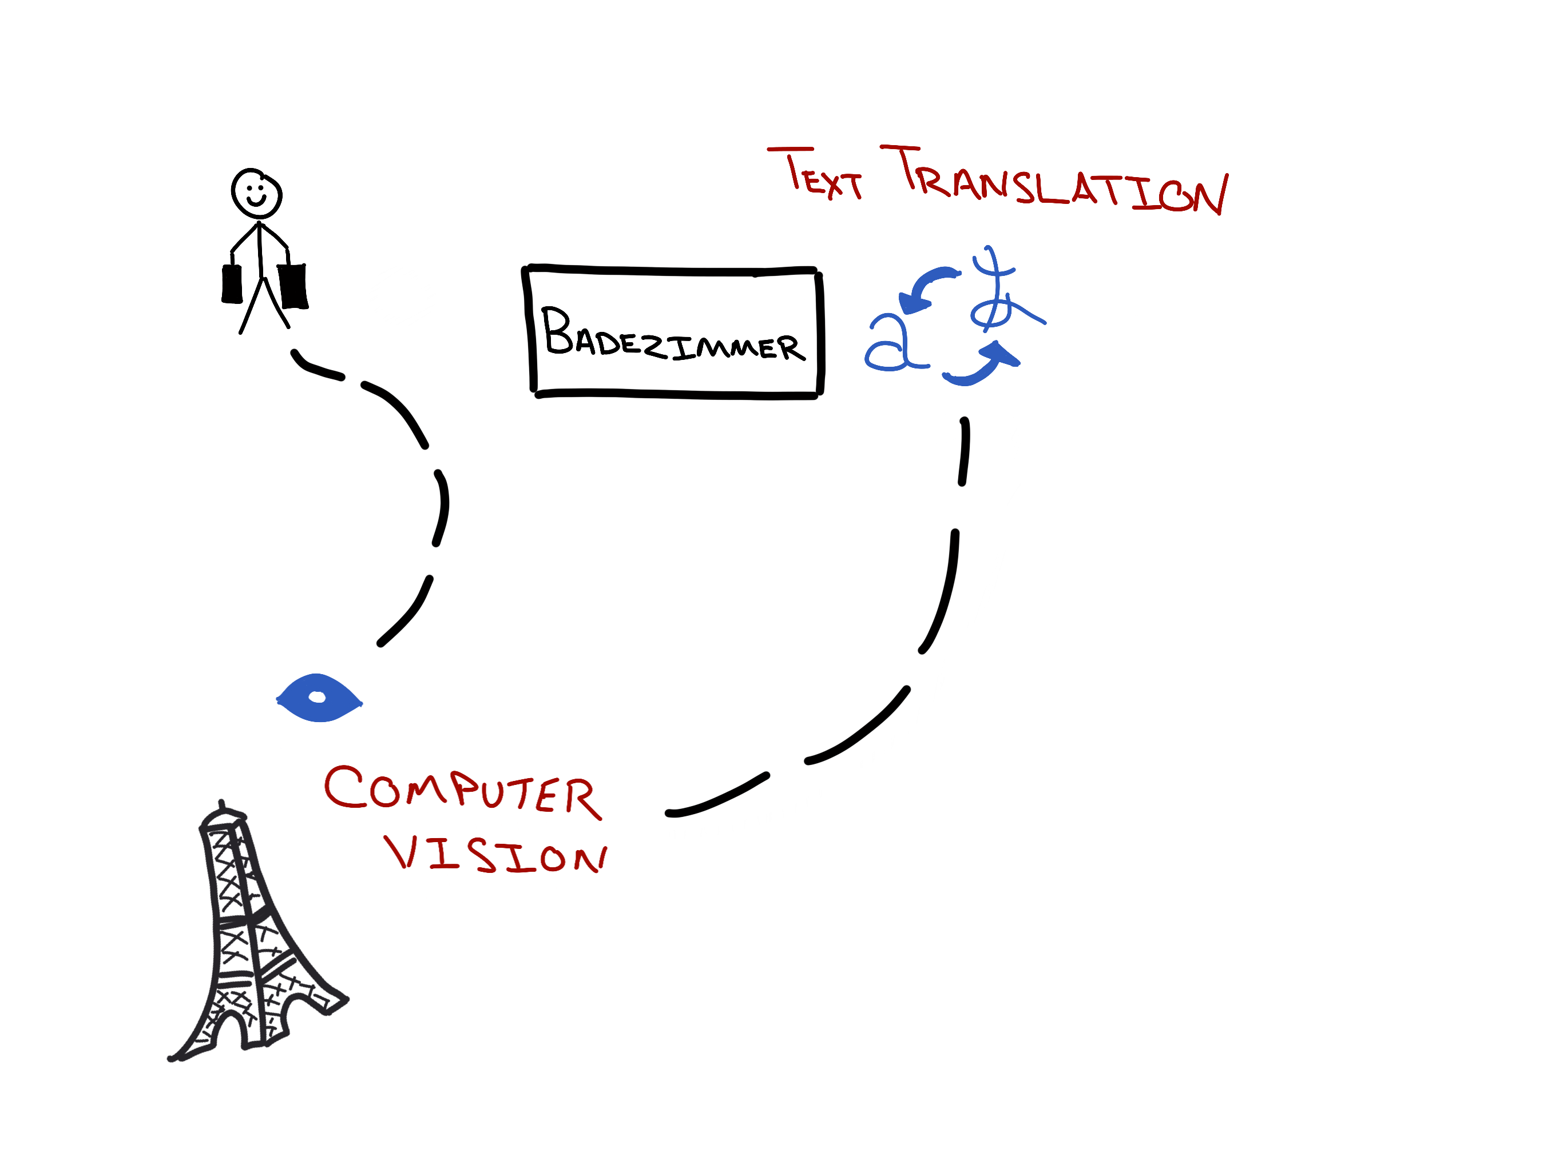
The Vacation…

Slide 17
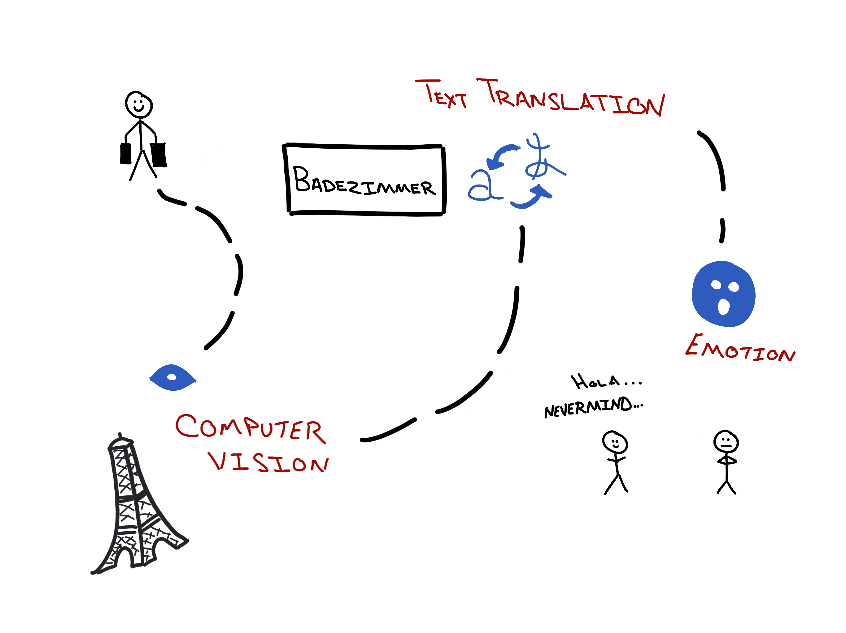
The Vacation…

Slide 18

Computer Vision
What’s in a photo??

Slide 19
Tag images…
Sunny
Outside
Tree
Person
Water
Notes:
Mention it will include percentages

Slide 20
Categorize images…
Outdoor->Ocean/Beach
Outdoor->Water
Scene->Sky->Sun
Object->Plant->Tree
People

Slide 21
Describe images…
Person laying on the beach
Notes:
Mention it will include percentages

Slide 22
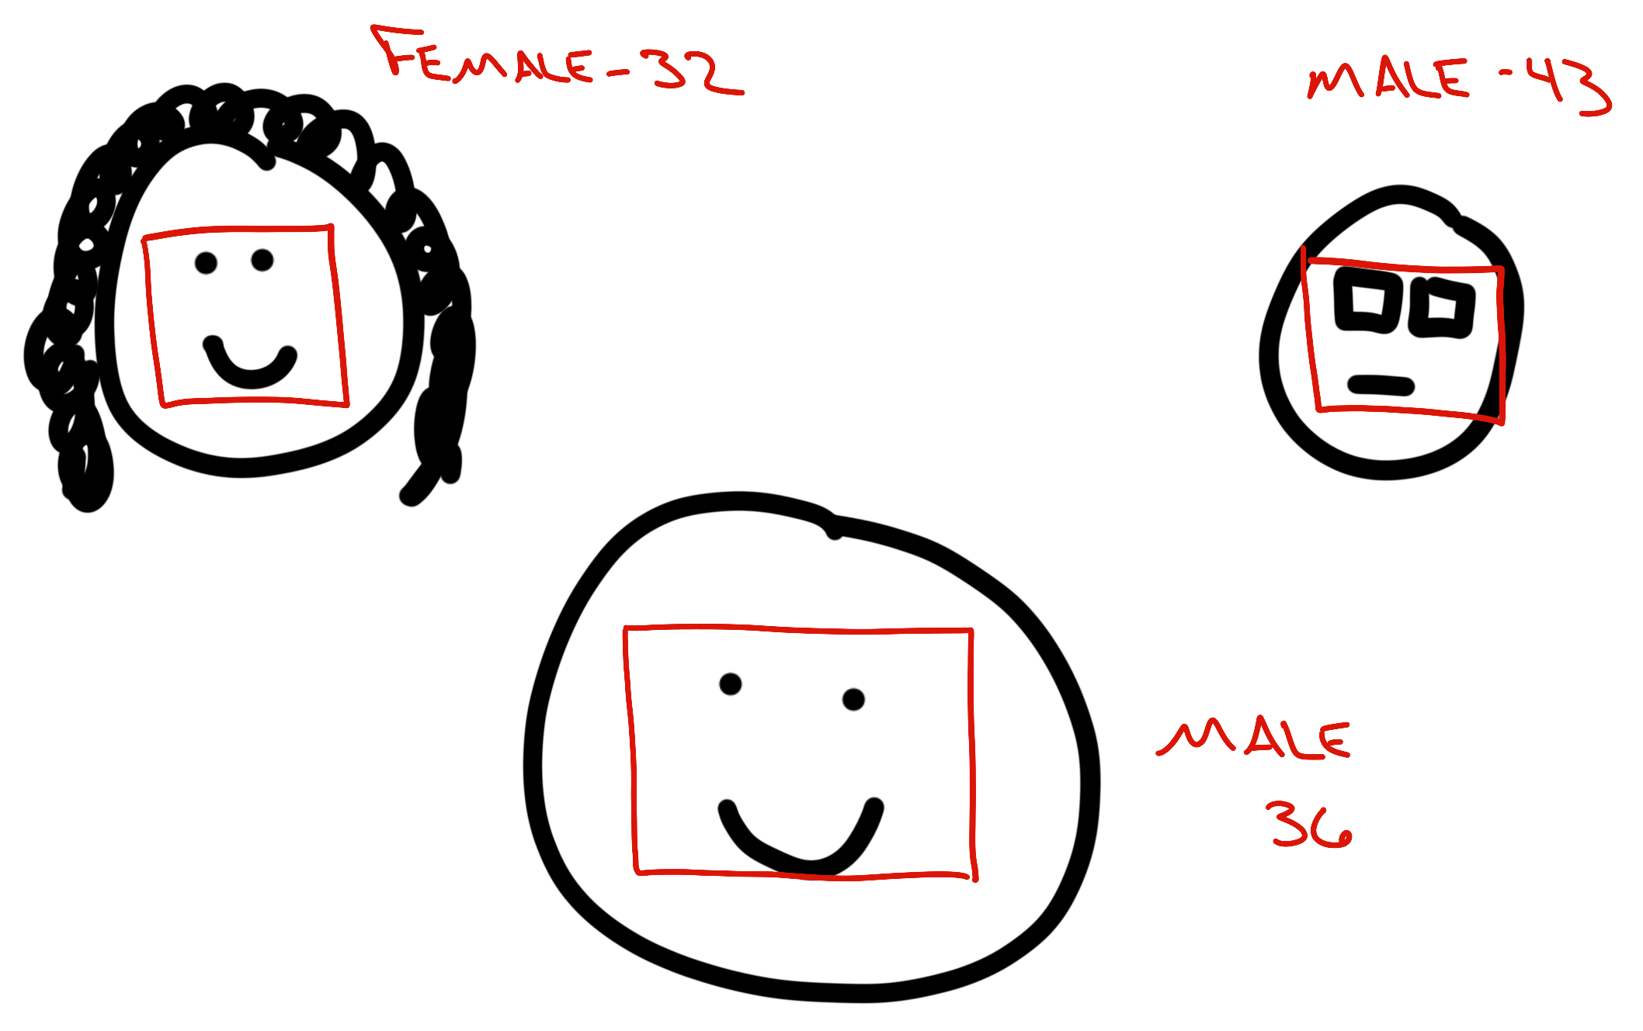
Detect faces…
Gender
Age
Coordinates in image

Slide 23

OCR…
Including handwritten
Corrects rotation
Reads blocks
Separately
Notes:
Mention it will include percentages

Slide 24
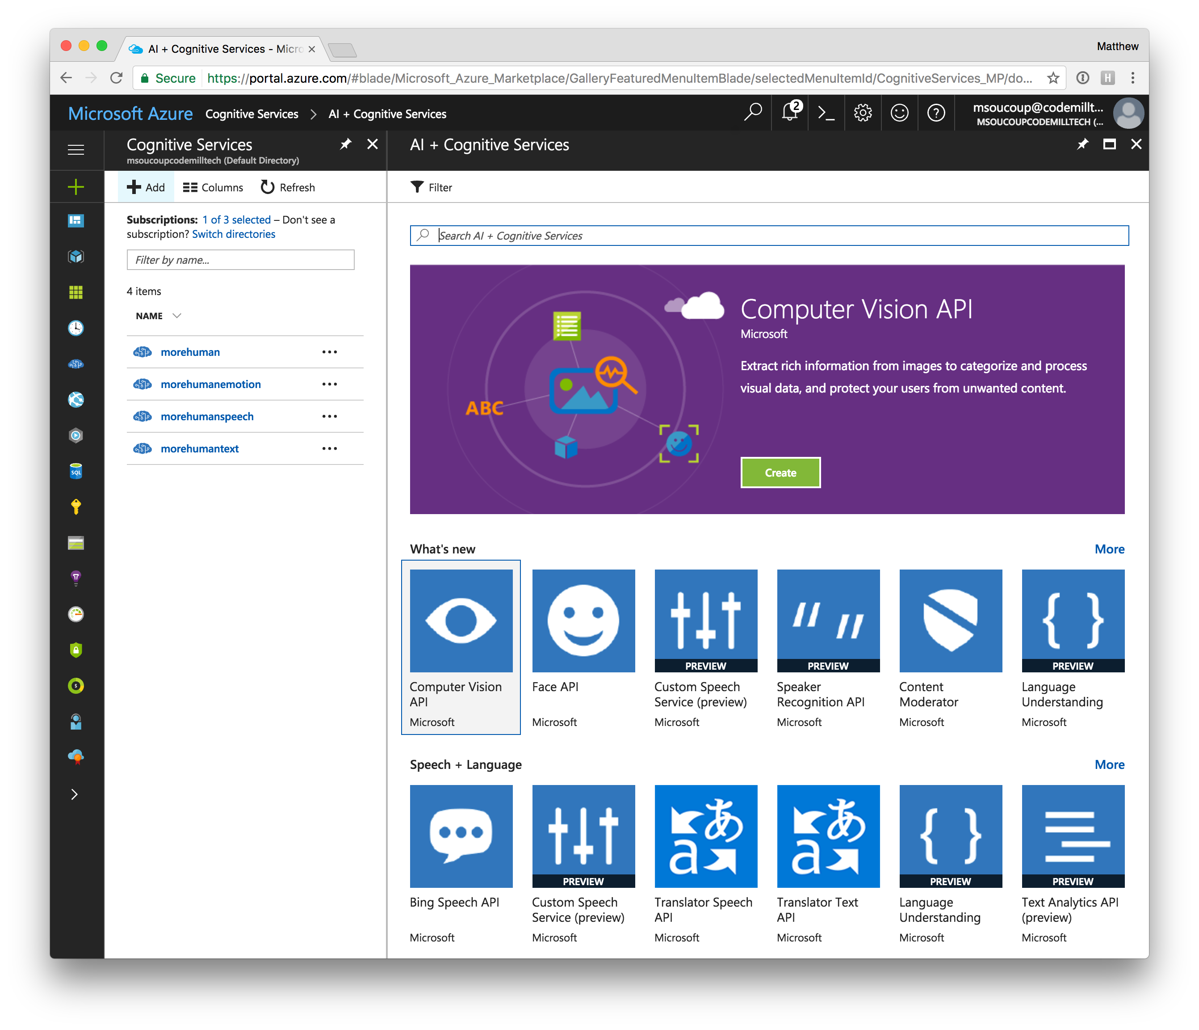
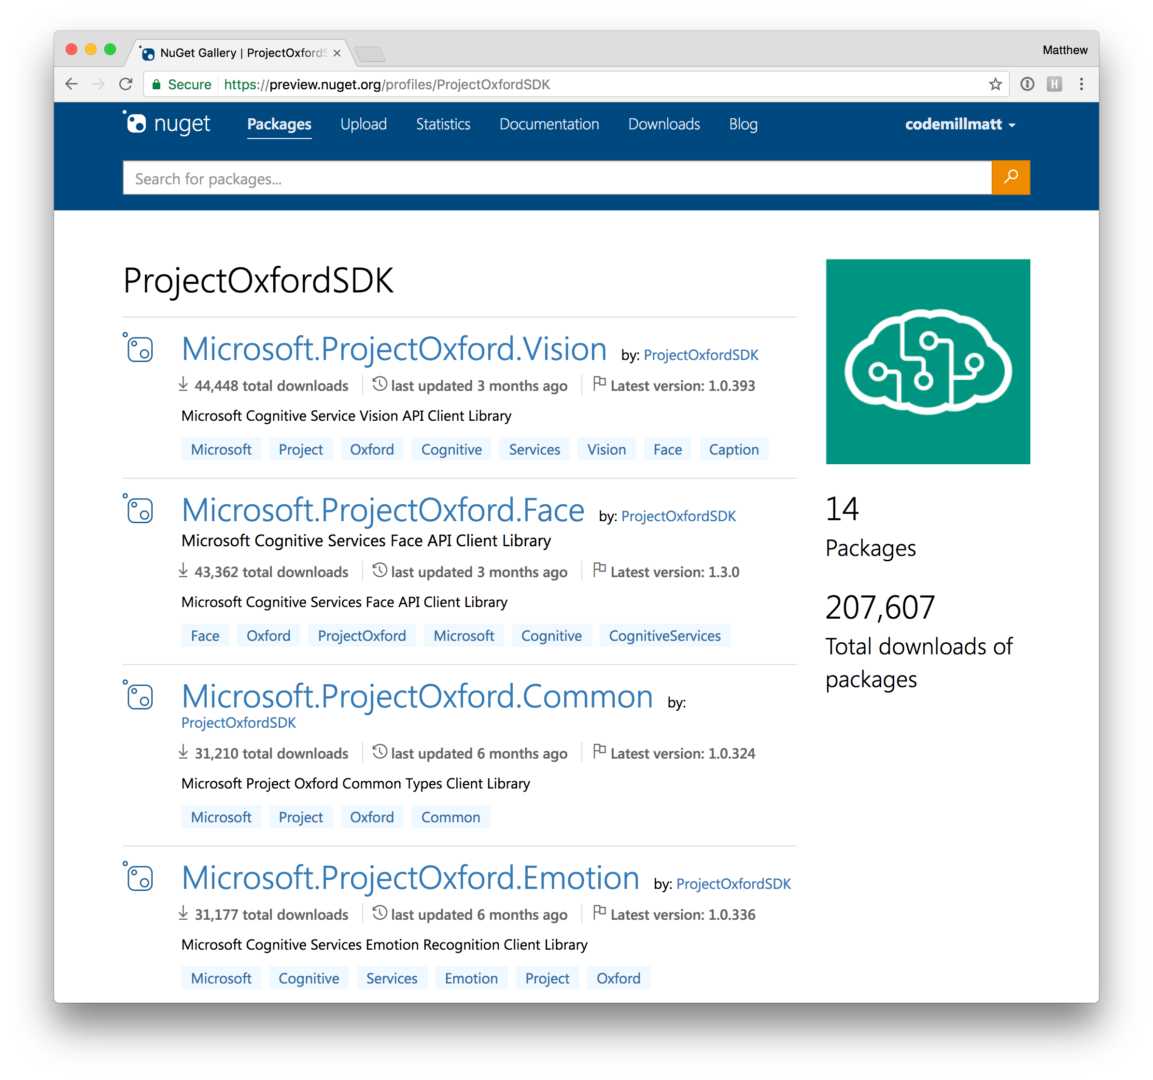
Creating a vision service

Slide 25


Slide 26
The Vacation…

Slide 27
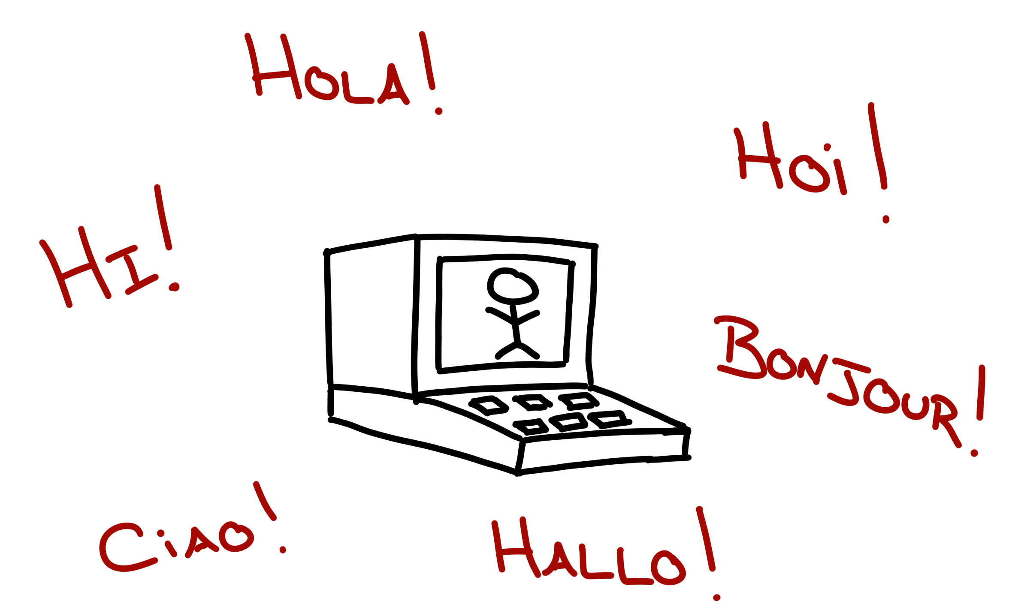
Text Translation
The multilingual machine…

Slide 28
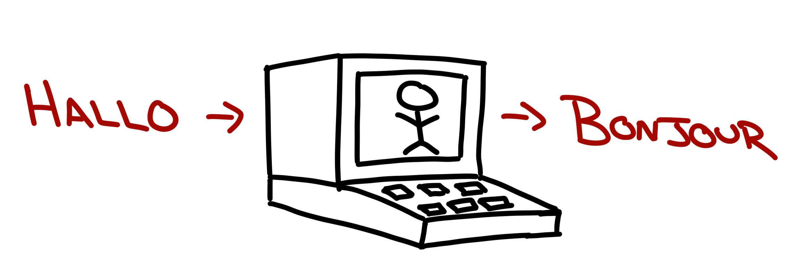
Translate text…

Slide 29
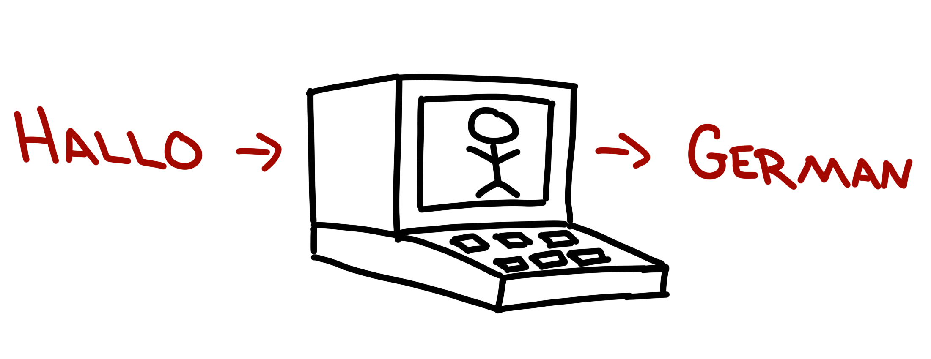
Detect language…

Slide 30

Speak!!!

Slide 31
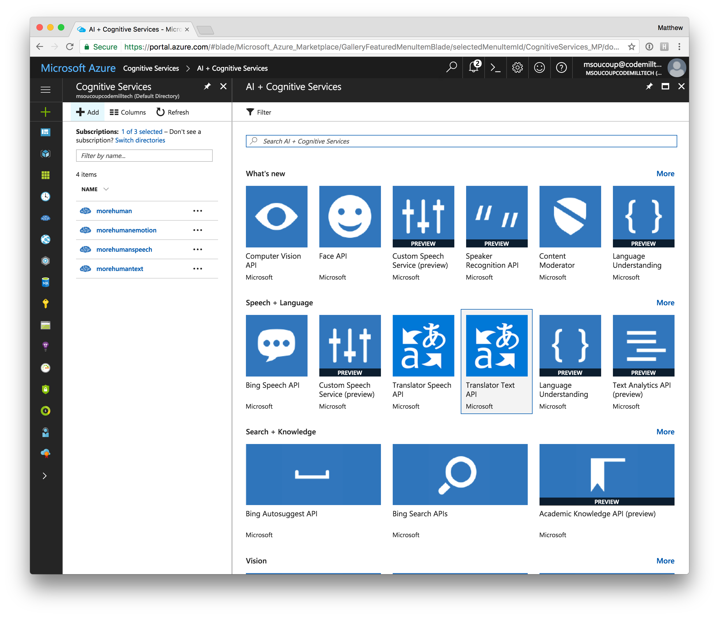
Azure setup

Slide 33
The Vacation…

Slide 34

Emotion API
The feeling cloud…

Slide 35

Score emotions in photos

Slide 36
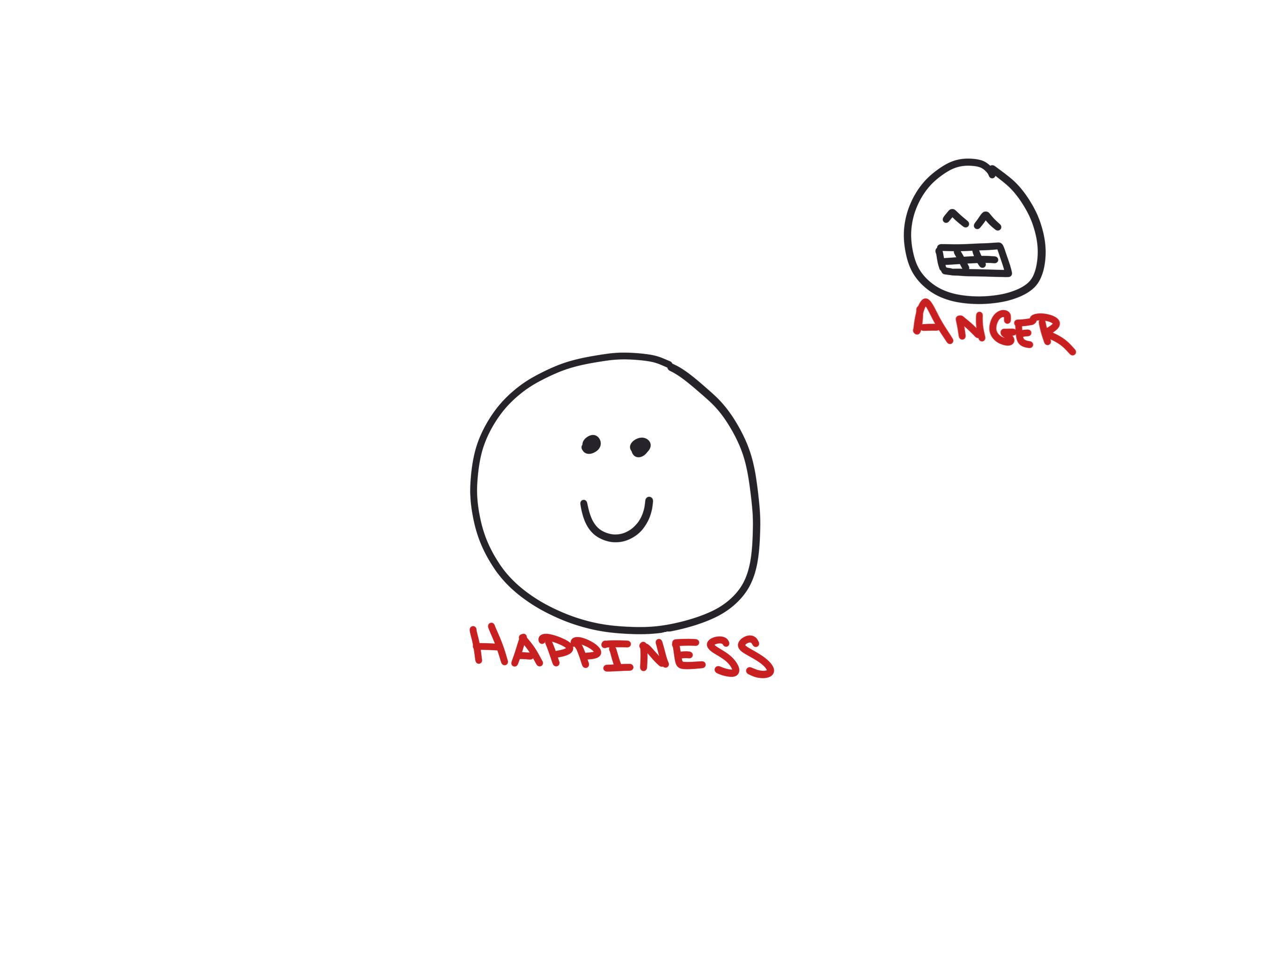
Score emotions in photos

Slide 37
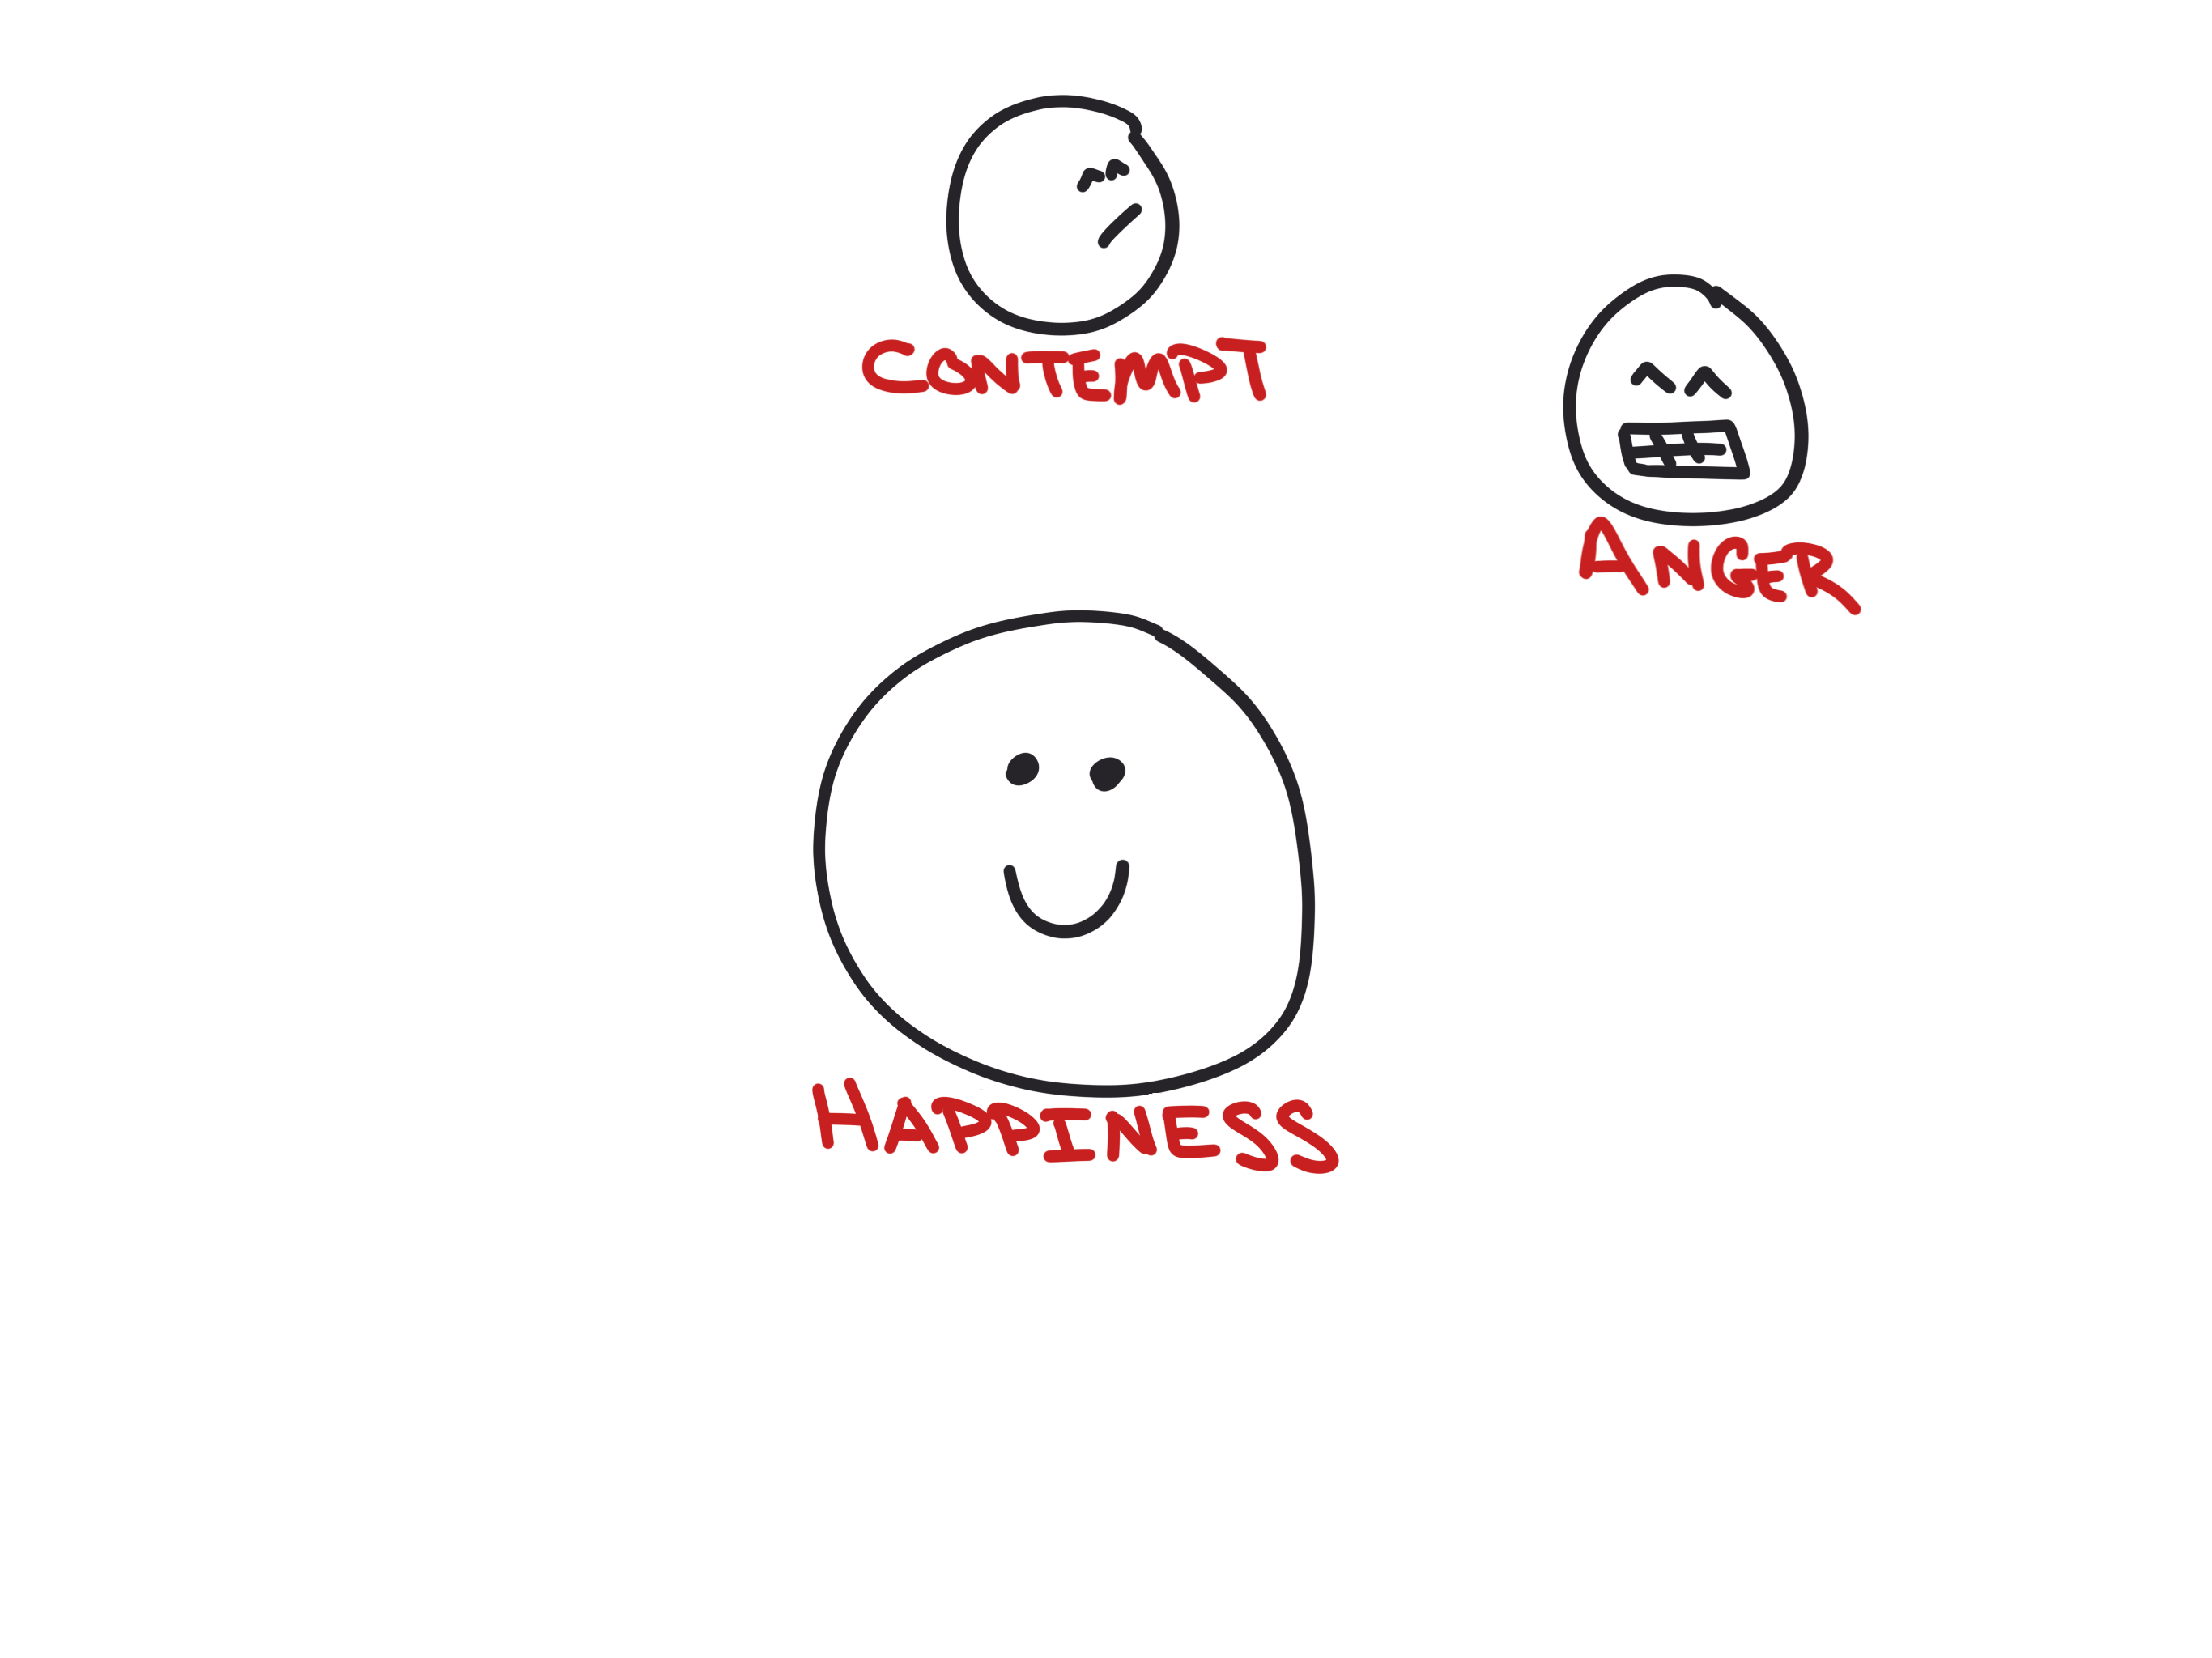
Score emotions in photos

Slide 38
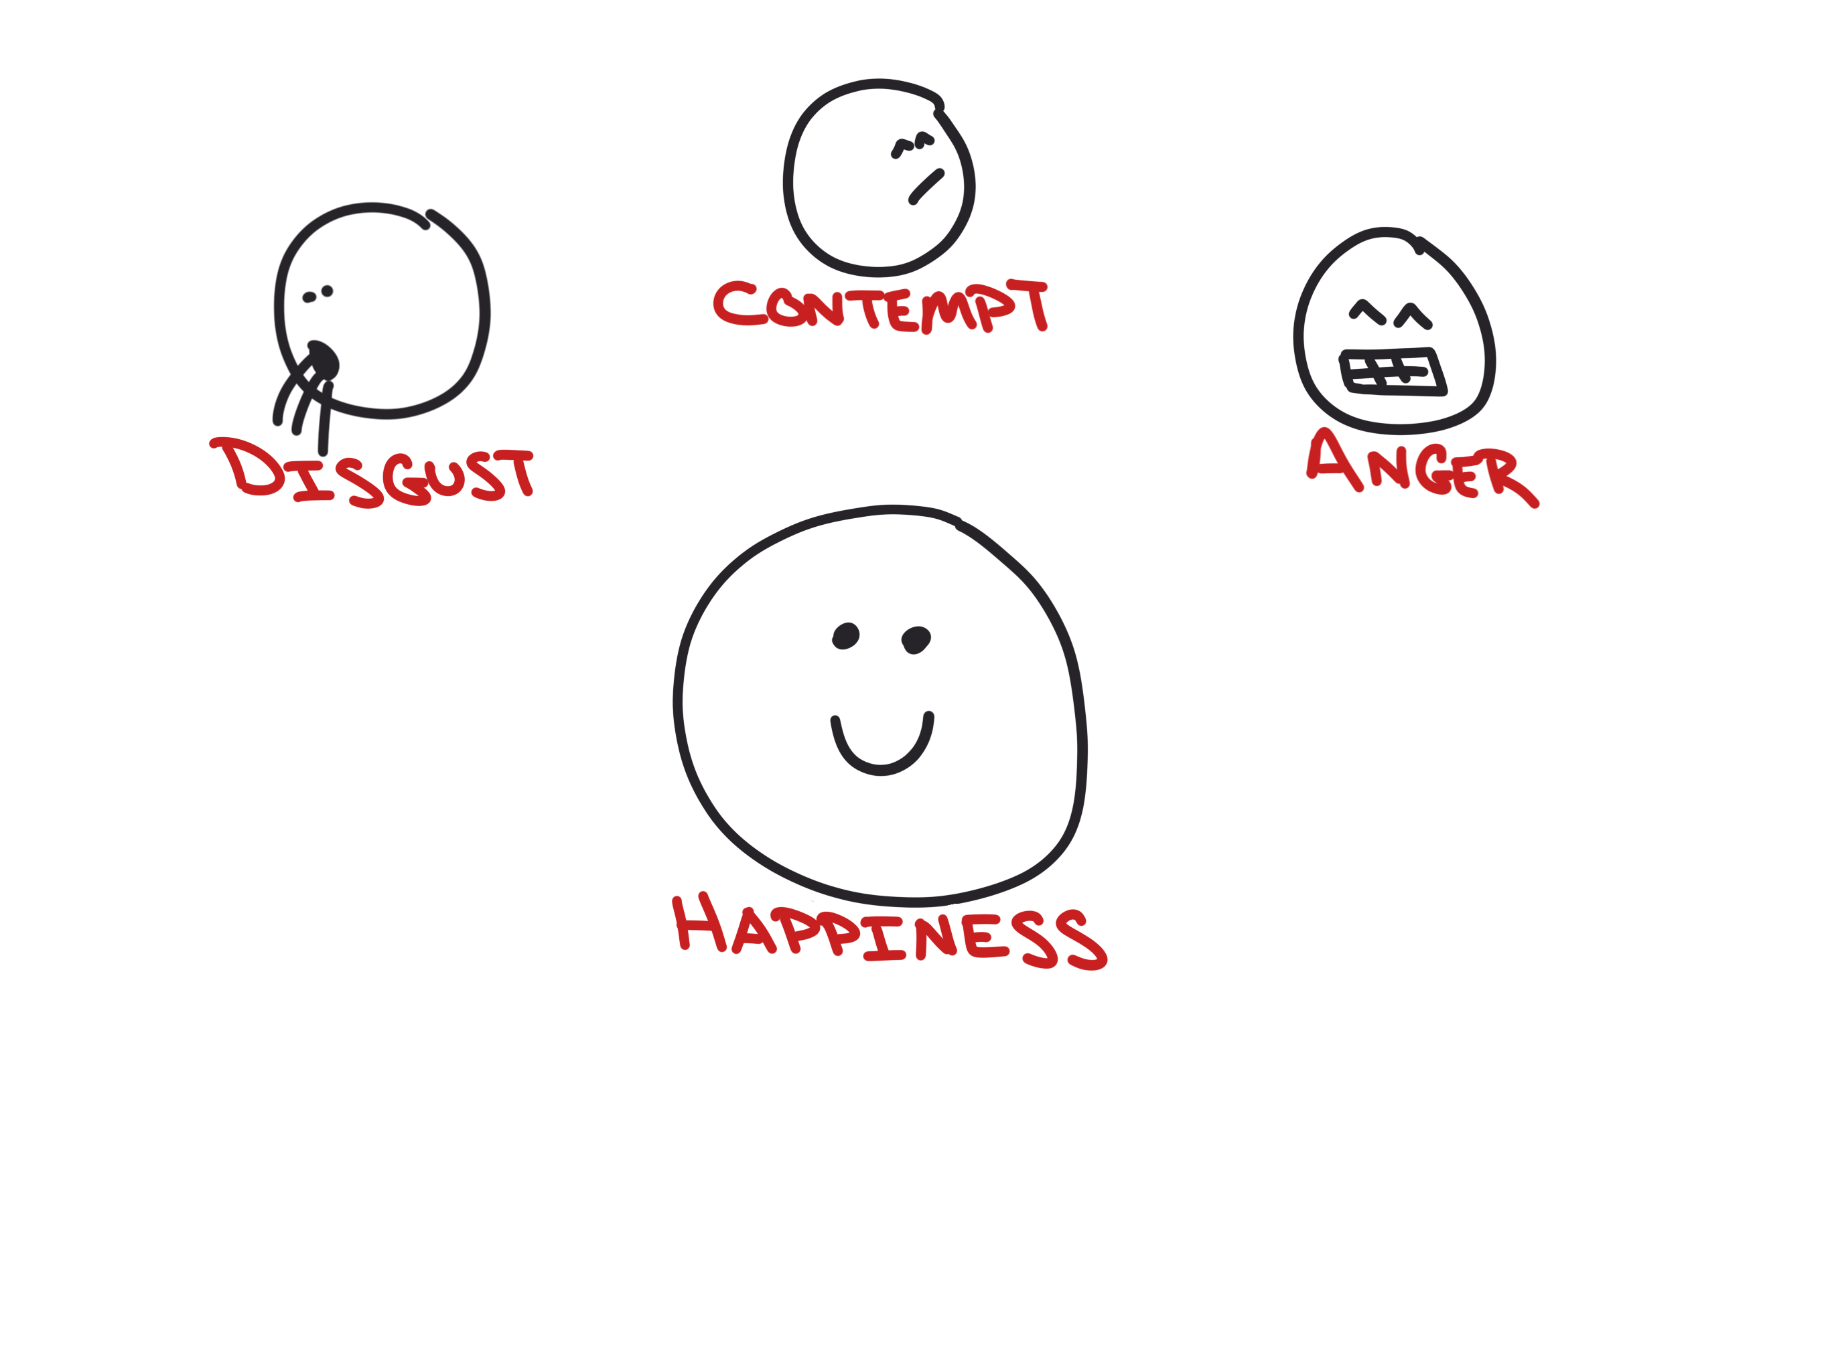
Score emotions in photos

Slide 39
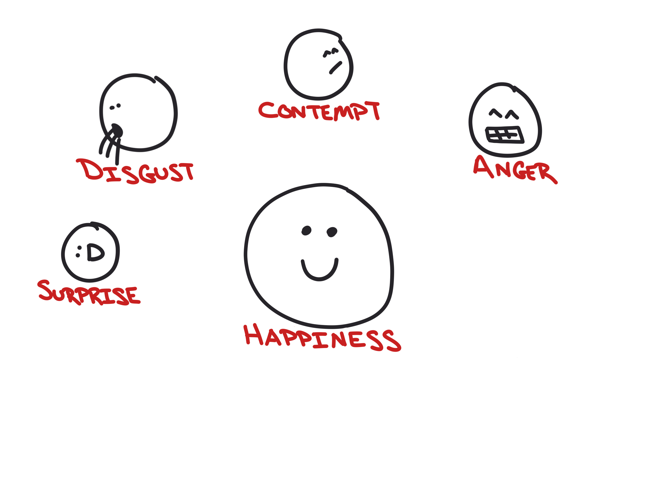
Score emotions in photos

Slide 40
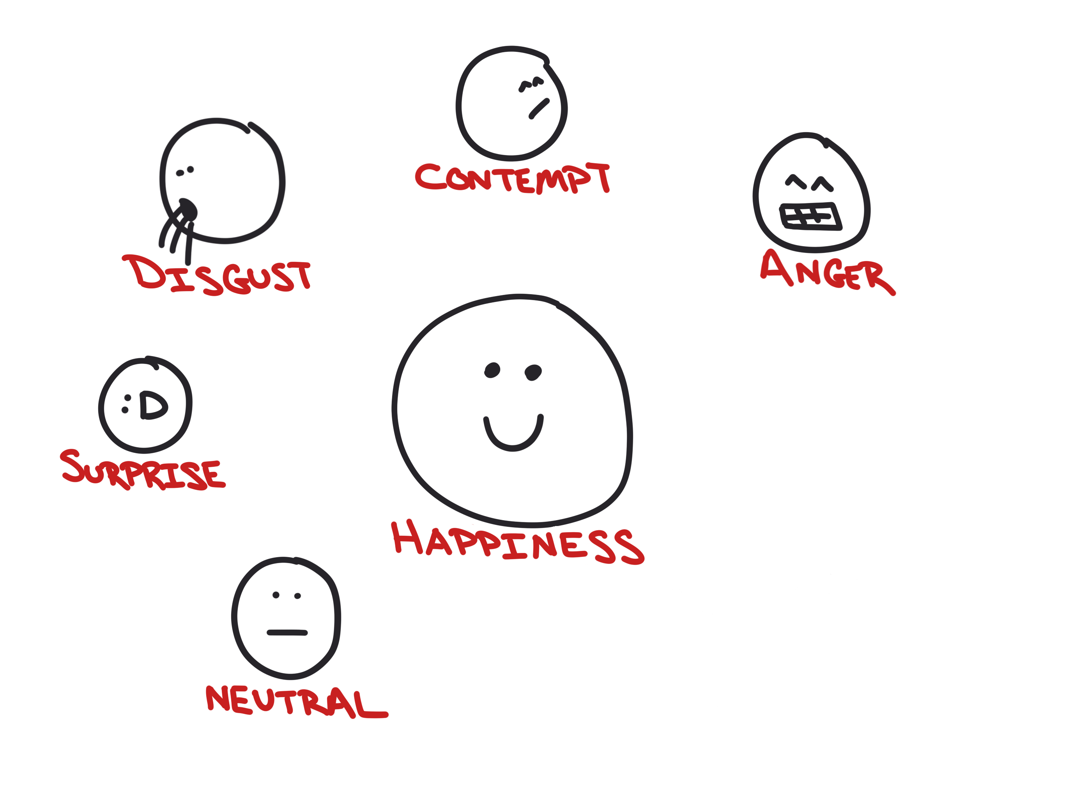
Score emotions in photos

Slide 41
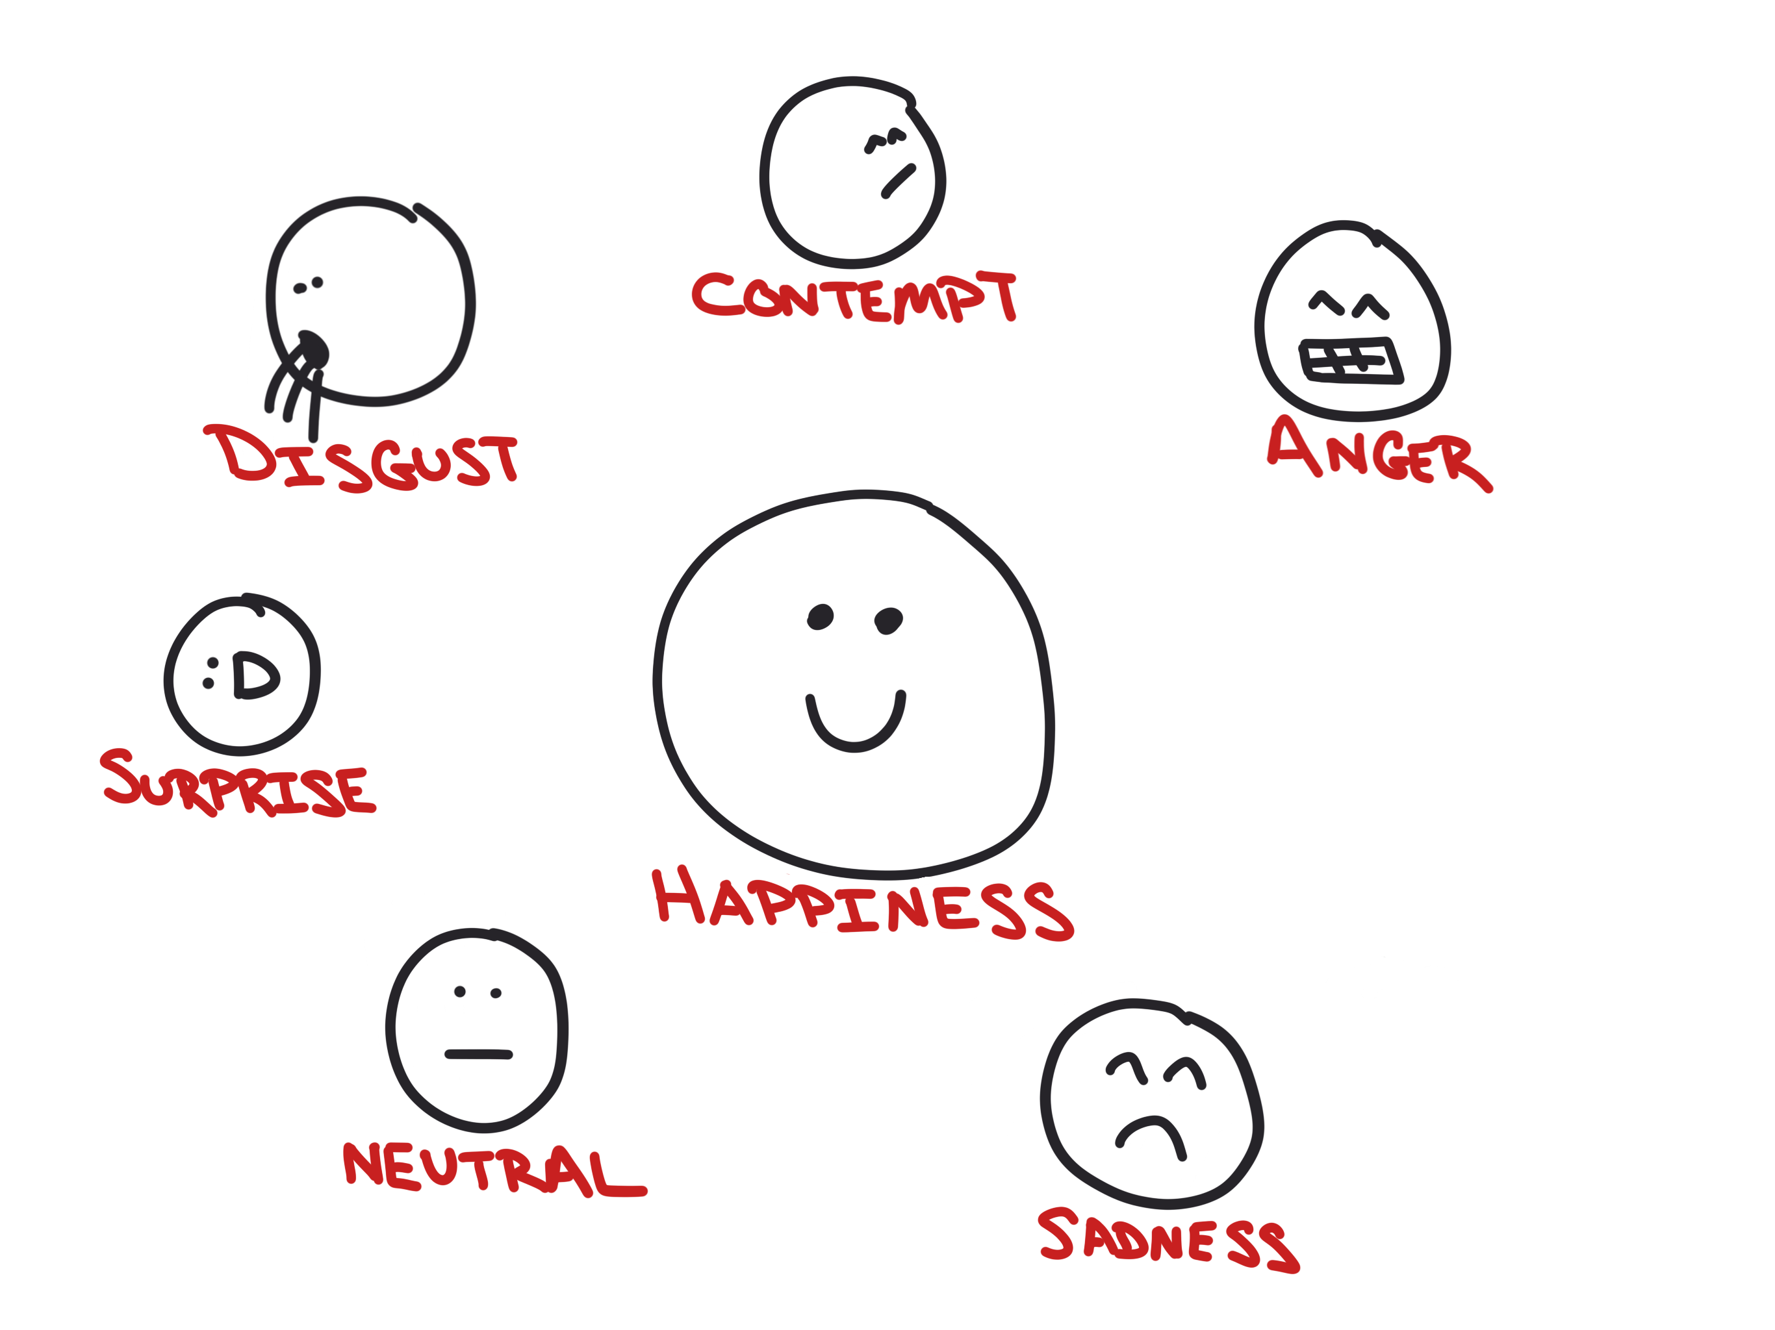
Score emotions in photos

Slide 42
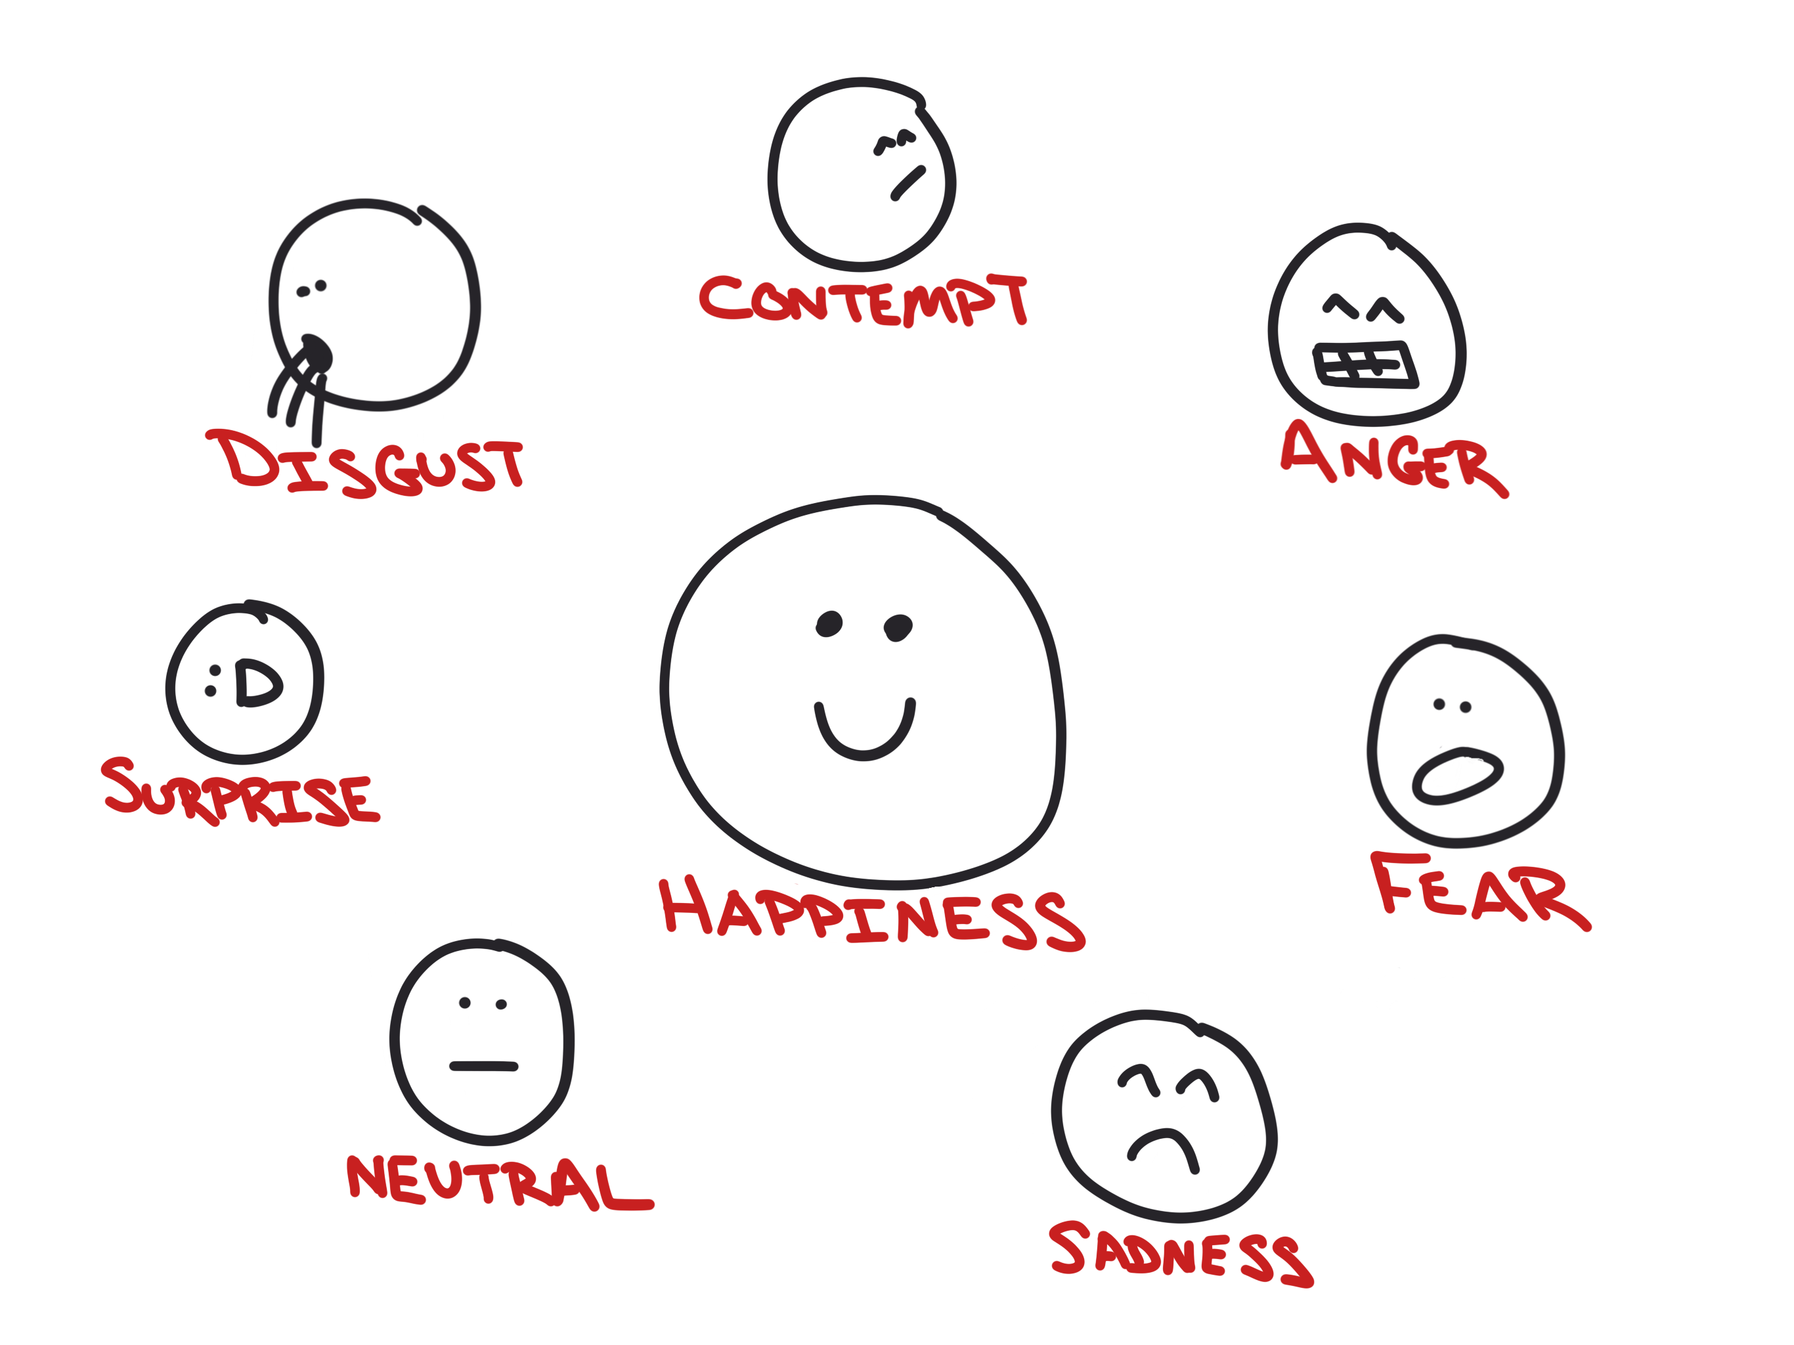
Score emotions in photos

Slide 43
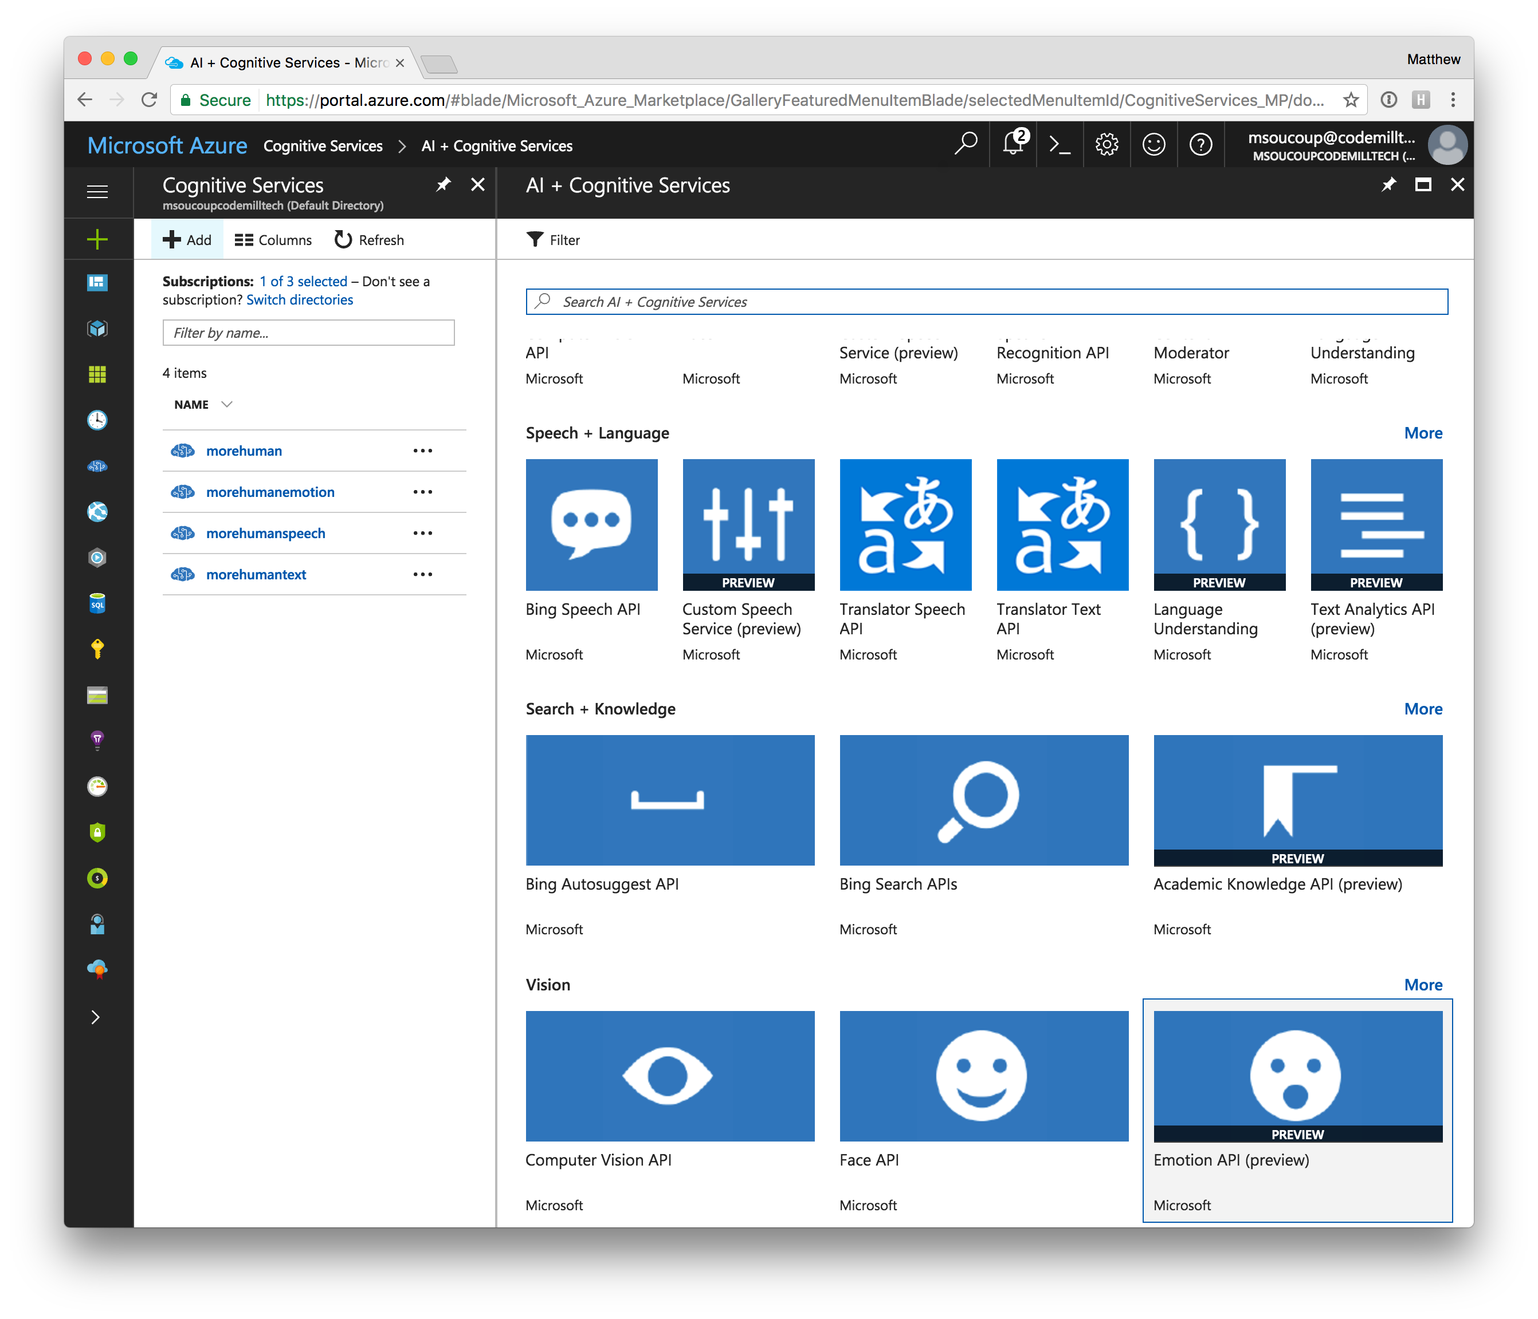
Azure setup

Slide 45
The Vacation…

Slide 46
Making Apps More Human
AN INTRO TO MICROSOFT’S COGNITIVE SERVICES
Matthew Soucoup
PRINCIPAL
@codemillmatt codemilltech.com
Headshot optional

